Slide 1
Advanced Systems Analysis and Design How to Demo SOFT 30121 L23 Presented By Nigel King ACMA CGMA PCM Nigel.King@ntu.ac.uk

Slide 2
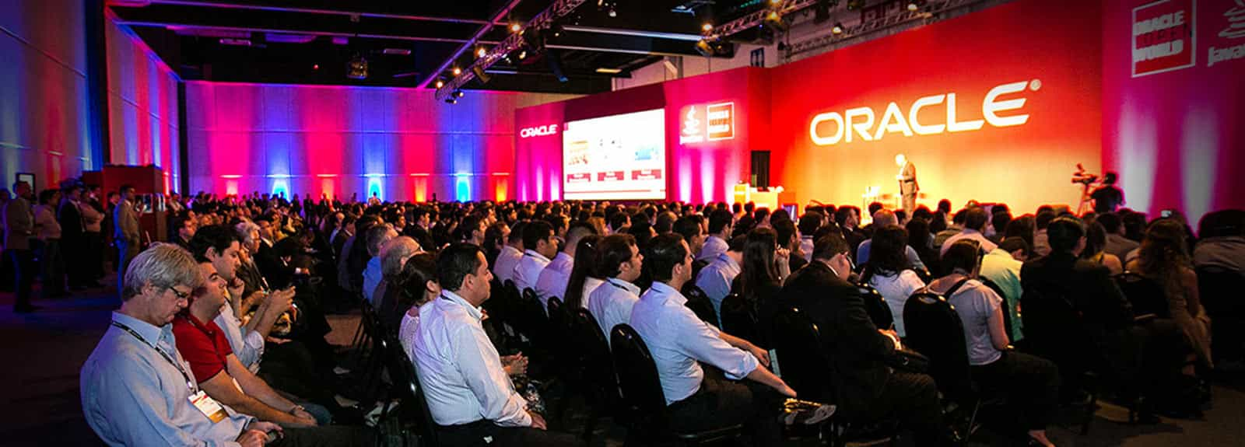
How to Demo

Slide 3
The Big Picture
Everybody should be able to sell
Why people buy
Difference between sprint review demo and sales demo
Tell the story and let us know who you are
Some example demoes

Slide 4
Everybody should be able to sell
My mission is for you to have long successful careers.
As such I should teach you to sell
We are very fortunate that as software engineers, we probably get to design, build, market and sell in our careers.
Internally, good demoes get projects sponsored
As your career progresses you are likely to do more product management than pure engineering
Good product managers teach sales people how to sell their product

Slide 5
Why people buy
PAIN
NEED
FEATURE
BENEFIT
People buy features, because they believe they will benefit.
Those features should satisfy a currently unmet need.
However-People make a decision because they are avoiding pain.

Slide 6
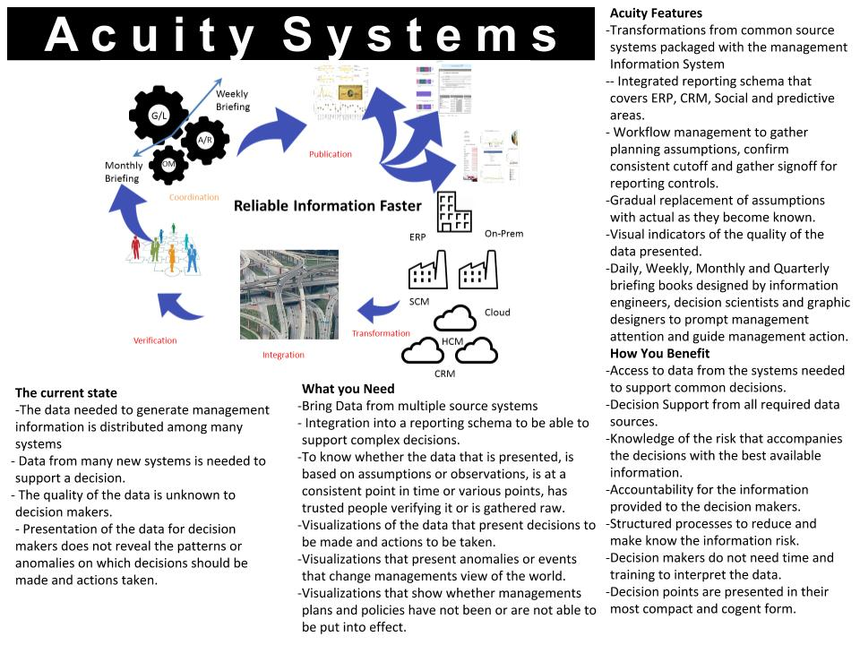
Why people buy. An example data sheet.

Slide 7
Difference between sprint review demo and sales demo
Your sprint demoes are good practice but your objective is different.
You are trying to show the user story
It is engineering demoing to product owner
Your sales demo is product owner to customer

Slide 8
Roles in the Buying Process
INITIATOR first identifies the need to buy a particular product or service to solve an organisational problem;
INFLUENCER (their) views influence the buying centre's buyers and deciders;
DECIDER ultimately approves all or any part of the entire buying decision -- whether to buy, what to buy, how to buy, and where to buy;
BUYER holds the formal authority to select the supplier and to arrange terms of condition;
USER consumes or uses the product or service;
GATEKEEPER controls information or access or both, to decision makers and influencers.

Slide 9
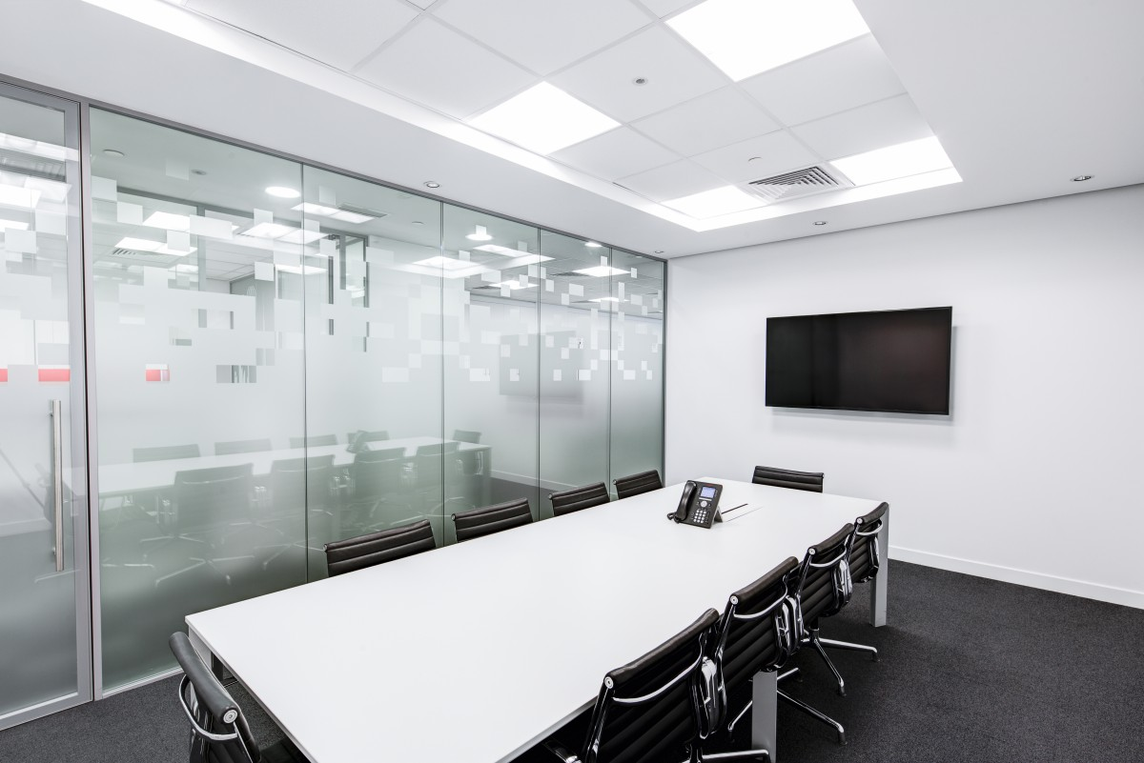
Seating Arrangements
You will be at the front
You want a colleague at the back to divert attention if you get into trouble.
Your customers are likely to be sat at the back on the opposing side.
It is bad form to outnumber the customers

Slide 10
The demo flow
There is generally some Powerpoint at the start.
Everybody accepts it
No-body really likes it
You have to position your product
Remember Pain/Need/Feature/Benefit
When you transition from PPT to demo
Make clear the role that you are in.
Explain the flow and let us know where you are in the flow
Explain your goals and point out when they are met
- The best software makes this clear without much help

Slide 11
Some demoes
Oracle Security Manager Console
Positioning
//youtu.be/Mmb0wFQtC7c?t=1541
Vignettes
https://youtu.be/Mmb0wFQtC7c?t=1650
SafePaaS Risk Analyzer
https://youtu.be/lY_u4T1iX78?t=335

Slide 12
Task for this afternoon
Break into your groups.
Watch one of the demos
Give me
2 things that I did well in the demo
2 things that I did badly in the demo
We will review the suggestions from each group in the 6:00 lecture.

Slide 13
Next Lecture
Review your findings

